Slide 1
Probability
By : L VINAY RAJIV REDDY

Slide 2
Probability
The likelihood of occurrence of any event is called as probability.
Range : (0-1)
Eg: In tossing a coin :
The outcomes are head/ tail
As both have equal chances, p(head)=p(tail) =0.5
sample set ={ H, T}
Sum of all elements occurrence =1.
Formula is P=(no. of desired outcomes/ total no. of outcomes)

Slide 3
Mutually Exclusive Events
Any 2 events that cannot occur at a time.
Tossing a coin and getting a head & tail can’t occur simultaneously.
P(A U B) = P(A) + P(B)
A B

Slide 4
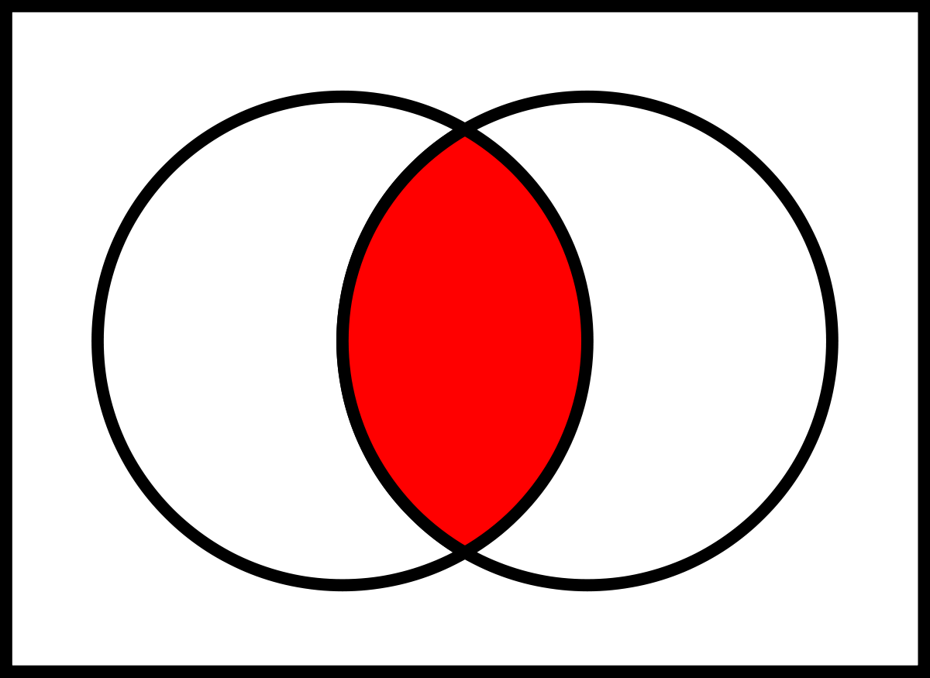
Mutually Inclusive Event
Events which aren’t mutually exclusive comes under this.
Eg: Events of getting a jack and a diamond comes under this.
P(AUB) = P(A) + P(B) – P(A 󠆀 AND B )
Jack Diamond
3
1
12

Slide 5
Independent Events
If the outcomes of 1st event doesn’t affect on the outcomes of the 2nd event.
P(A AND B) = P(A).P(B)
Eg: While rolling 2 diff. dies, the events of getting odd number on 1st die and even number on 2nd die are independent events.

Slide 6
Dependent Events
If the outcomes of 1st event shows an affect on the outcomes of 2nd event, is called as dependent events.
P(A AND B) = P(A).P(B/A)
Eg : A jar contains 3 white balls, 2 black balls, 3 blue balls. What is the probability of getting 2 white balls in 2 draws and without replacement.
P(2 white balls )= [(3/8) * (2/7)]
= (6/56) = 3/28 (0.107)

Slide 7
Conditional Probability
It is the probability of occurrence of 2 dependent events one after the other.
For dependent events :
P(A AND B) = P(A).P(B/A)
Here P(B/A) is the conditional probability
From above equation :
P(B/A) = [P(A AND B)/P(A) ]

Slide 8
Bayes Theorem
To calc. Conditional Prob. When the value of P( A AND B) is not available.
P(A AND B) = P(A).P(B/A) - (1)
P(A AND B) = P(B).P(A/B) - (2)
From (1) & (2), by equating them :
P(A).P(B/A) = P(B).P(A/B) – (3)

Slide 9
Hence Conditional probability of A, given event B has occurred is P(A/B).
P(A/B) = (P(B/A).P(A)) / P(B)
Similarly P(B/A) = (P(A/B).P(B)) / P(A)

Slide 10
Assignment -2
P(odd OR prime) on a spinner from 1-8 ?
Sample space ={1,2,3,4,5,6,7,8}
Odd (A) ={1,3,5,7} , Prime (B) ={2,3,5,7}
It is a mutually exclusive event.
P( A U B) = P(A) + P(B) – P(A AND B)
P( odd OR prime ) =P(odd) + P(prime) – P( odd AND prime)
= (1/2)+(1/2) – (3/8)
= (5/8)

Slide 11
For numbers in 1-9 , hat is the probability of getting a number less than 4 or 2 ?
P( <4 OR < 2) = P(<4) + P(<2) – P( <4 AND <2)
= (3/9) + (1/9) – (1/9)
= 3/9

Slide 12
Given : x , y are 2 independent events. P(x) =0.3 p(y) = 0.7
P( x AND Y) = 0.3 * 0.7 = 0.21
P( X OR Y) = 0.3 + 0.7= 1

